Slide 1

How background noise effects concentration
By Dale Smallwood

Slide 2
Introduction
For my research topic I chose to research how background noises can affect concentration.
In day to day life we tend to struggle focusing on tasks. I would like to find out, why we struggle, how to help and find a way to improve our concentration.

Slide 3
Why I find this topic really engaging and why I chose it
It could help others with further work or projects with the results I gathered.
Showed the participant taking part if noise could or not could assist them with focusing on tasks.
It could personally help me find out what helps me focus on future topics.

Slide 4
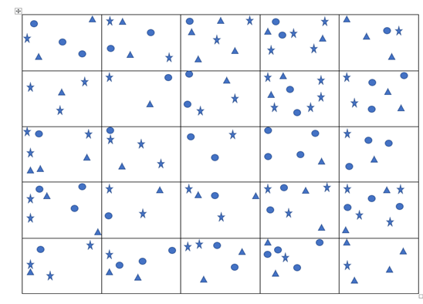
How I gathered my research
I created a table with different shapes as shown below and asked a set of questions which were.

Slide 5
The questions as followed
How many boxes contain :
(test one)
Three stars
Three triangles
Three circles
(test two)
Four stars
Three circles
Two triangles
(test three)
One star
One circle
One triangle

Slide 6
Research gathered and how
During asking each task provided, I had timed the participant, how long it took them to answer each question. I played a different range of sounds to see how it would affect the test.
For the star questions
I played a Youtube video of a baby crying to see how a bad / annoying sound would cause a loss or gain of concentration.
https://www.youtube.com/watch?v=d1MWxSUO4ts
For the circle questions
I played a Youtube of rain falling to see how a calming sound would effect concentration.
https://www.youtube.com/watch?v=jX6kn9_U8qk
For the triangle questions
I did not play any audio from a Youtube video as I needed a controlled answer.

Slide 7
The results and there meaning
From these results, the circles / good sound questions, were the fastest time and had no incorrect answers. Therefore a relaxing sound may improve your concentration.
Other than test three, the triangle questions / no sound control test, had the longest average time. Some participants also explained to me, they had issues focusing without any background noises. There was also, a couple of incorrect answers, which also supports, they lost concentration during the test.
Even though the star / bad sound questions were not the fastest, they still were faster than the control no sound, but there was also some incorrect answers.
These results show, that some participants, work better with sound.
(test one)
Three stars – 19.2 seconds (most incorrect answers)
Three circles -17.4 seconds (fastest time)
Three triangles - 24.2 seconds
(test two)
Four stars – 18.2 seconds
Three circles – 15.7 seconds (fastest time)
Two triangles – 33 seconds (most incorrect answers)
(test three)
One star - 18.6 seconds (most incorrect answers)
One circle - 16.2 seconds (fastest time)
One triangle 18 seconds (most incorrect answers)

Slide 8
Thank you for listening to my presentation.
I hope that my research helped you.
Do you have any questions?

